Slide 1
HAMANASI Truss Installation Graphics
22-28 February 2014

Slide 2
DAY 1
22 February 2014

Slide 3
Move Crane Into Position
DAY 1

Slide 4
Set Up Staging Area
DAY 1

Slide 5
DAY 2
23 February 2014

Slide 6
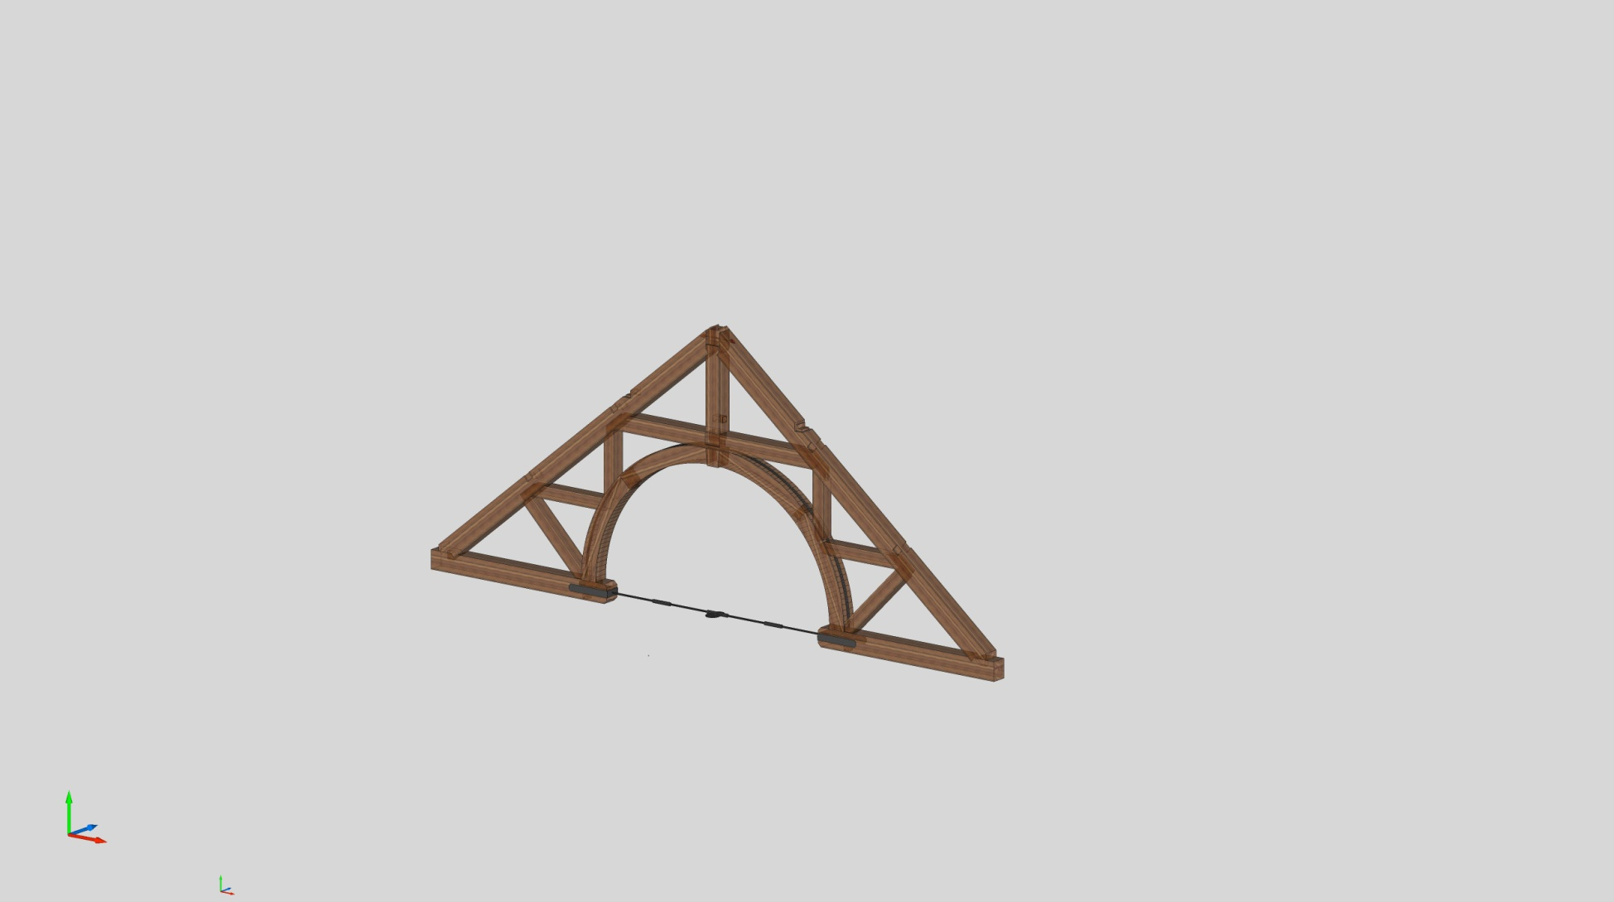
Fly and Fit Truss #1
DAY 2

Slide 7
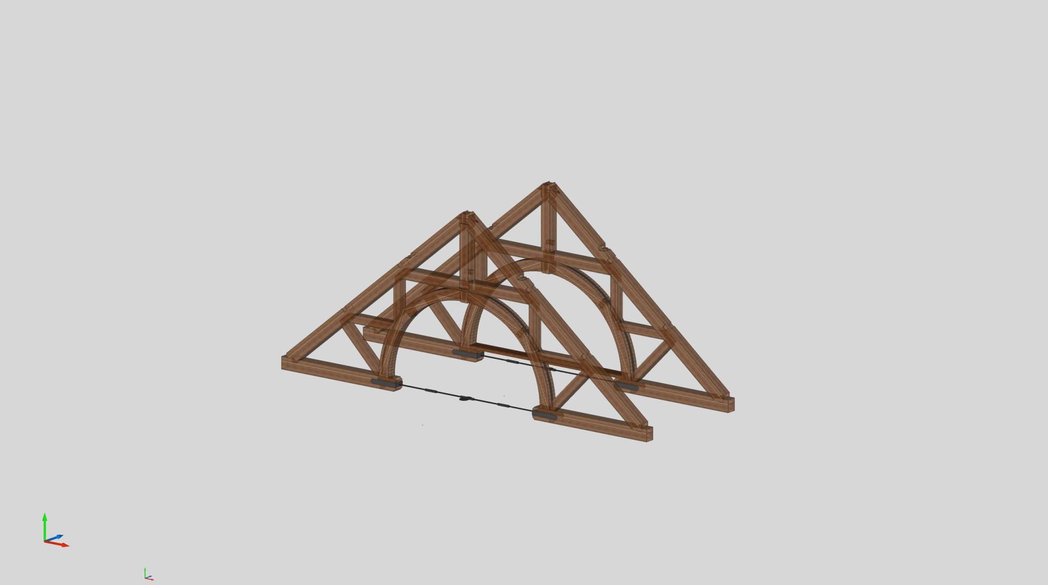
Fly and Fit Truss #2
DAY 2

Slide 8
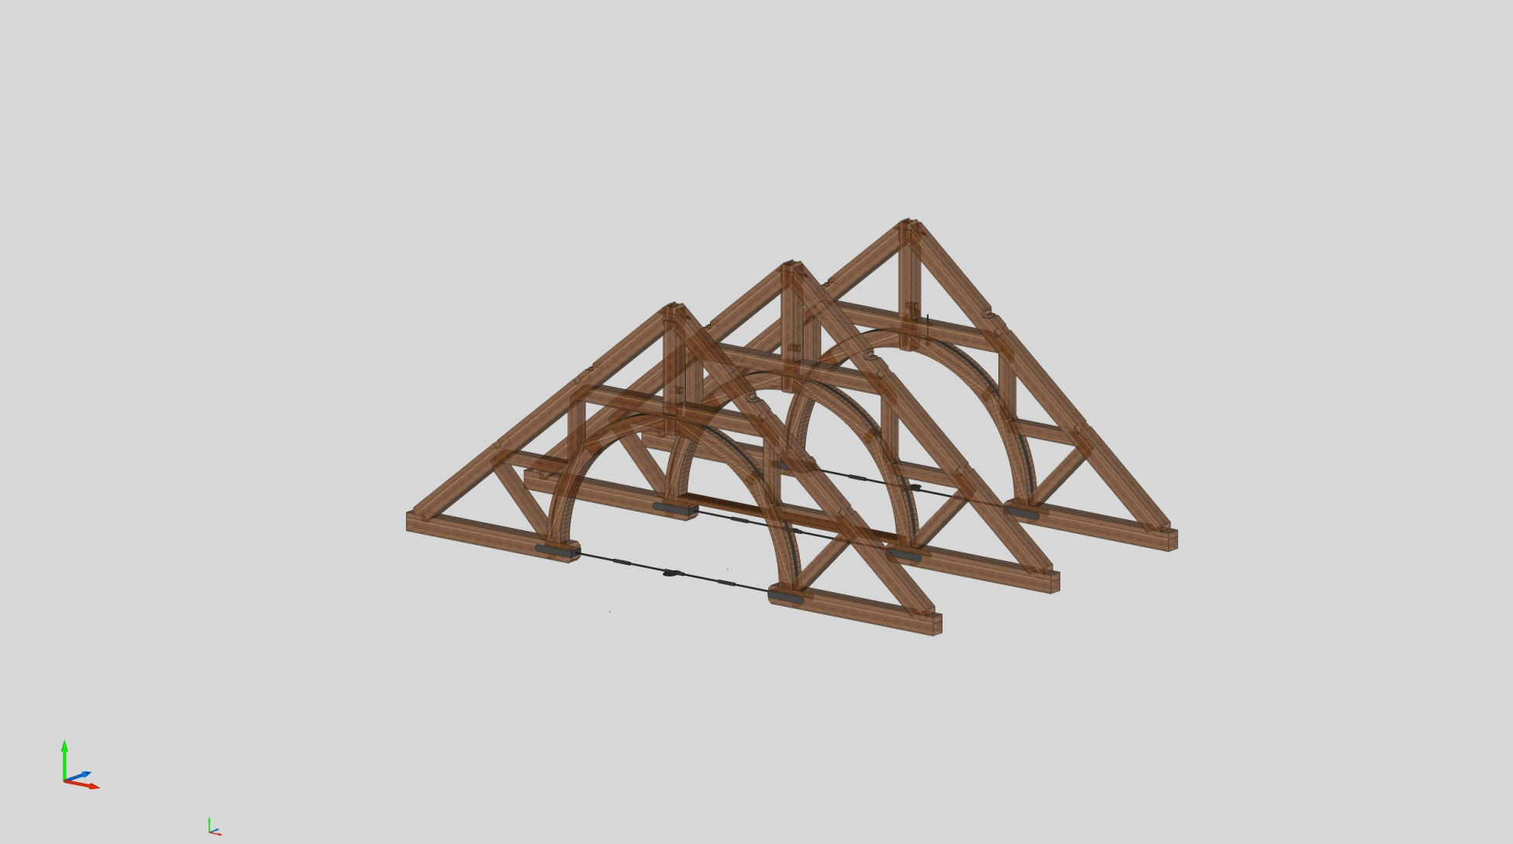
Fly and Fit Truss #3
DAY 2

Slide 9
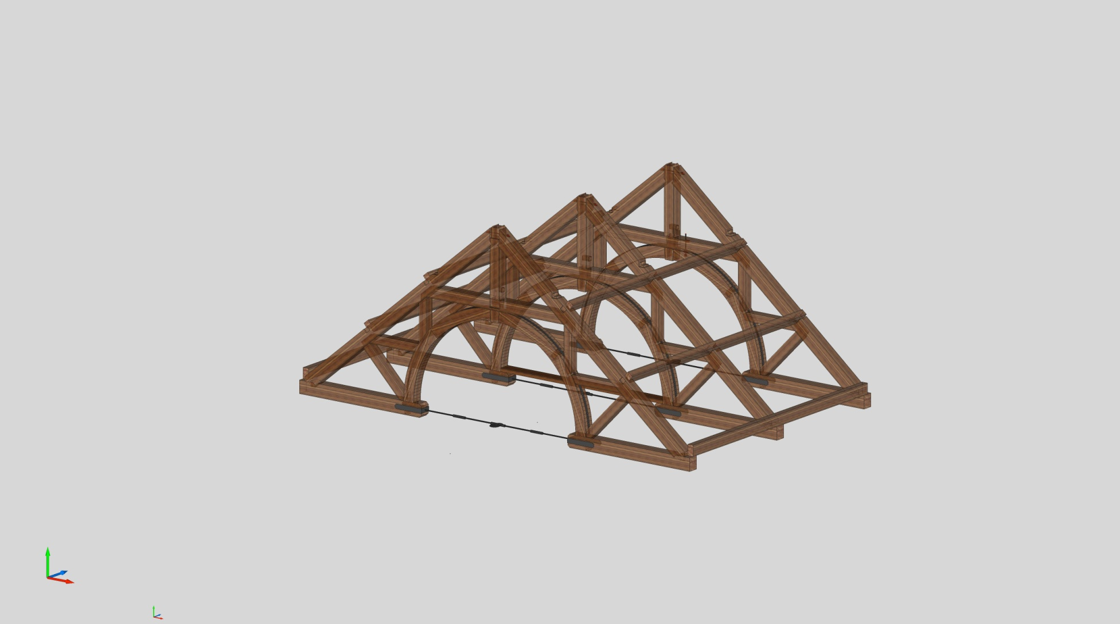
Install Rafter Plates + Purlins
DAY 2

Slide 10
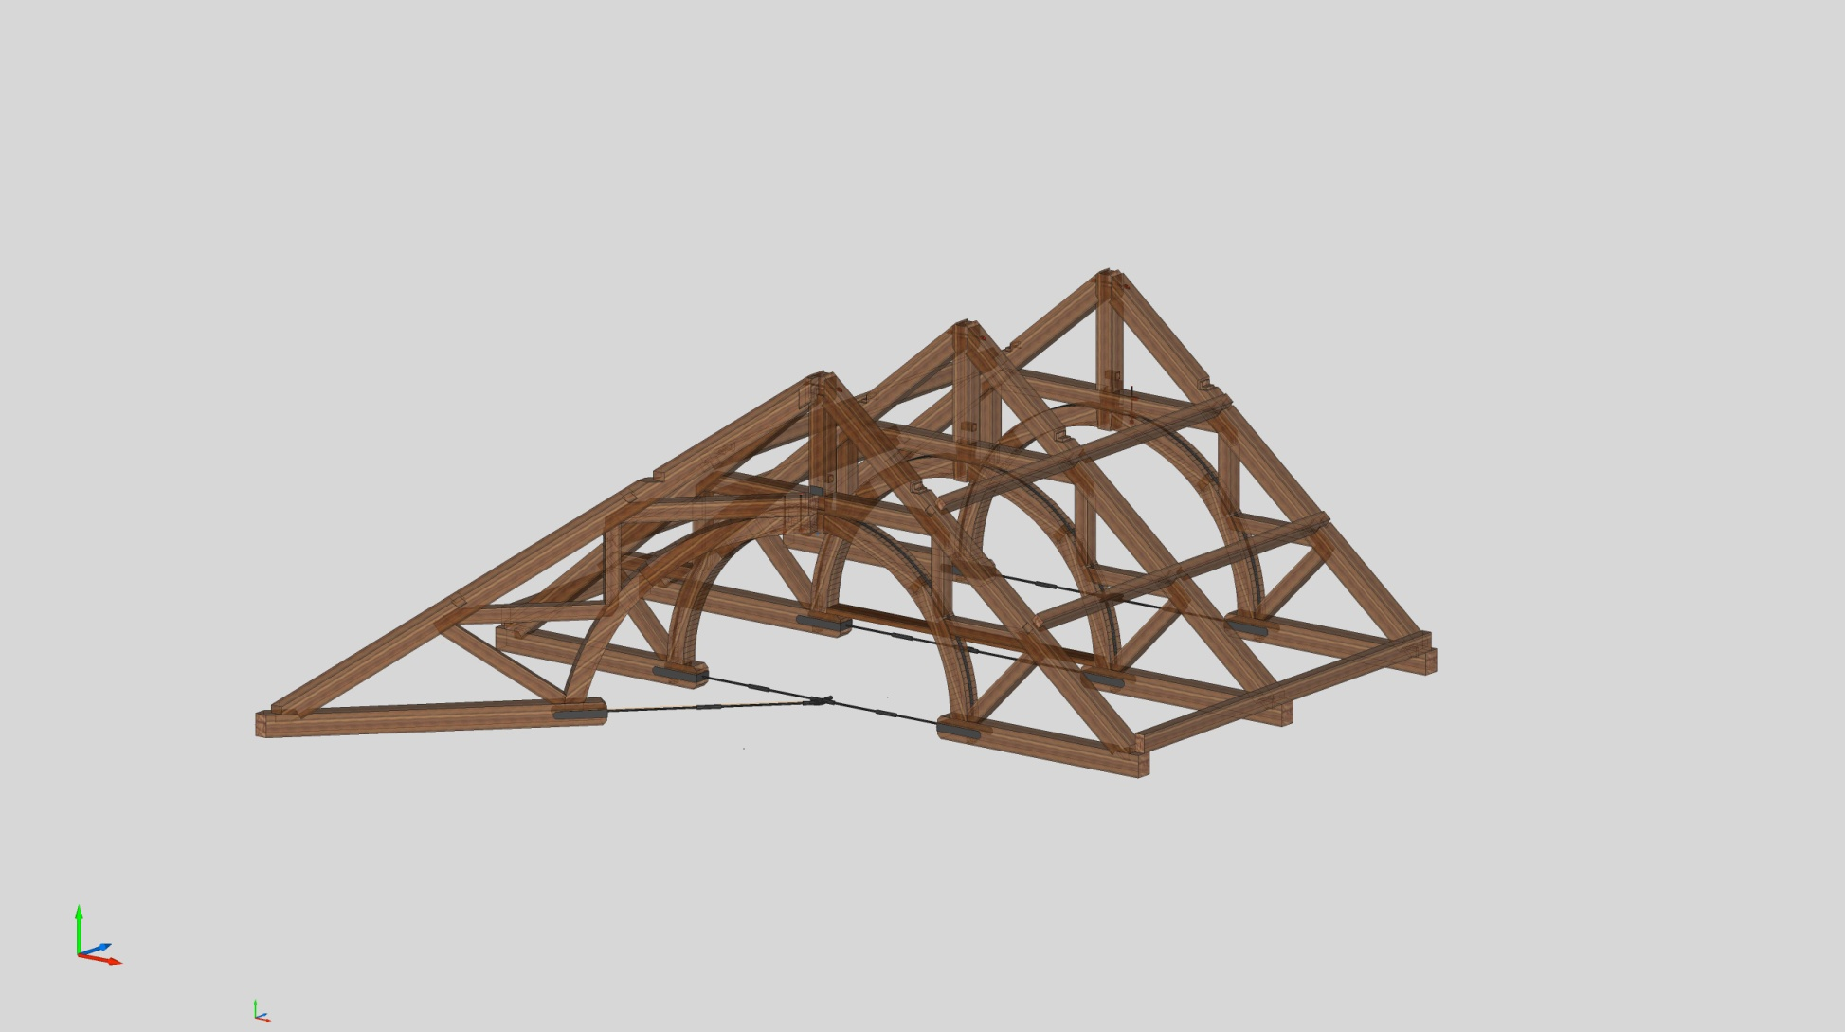
Fly and Fit Hip Truss - #1
DAY 2

Slide 11
DAY 3
24 February 2014

Slide 12
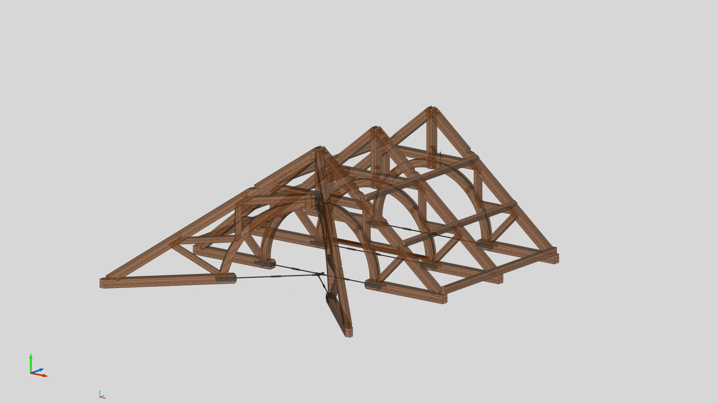
Fly Hip Truss - #2
DAY 3

Slide 13
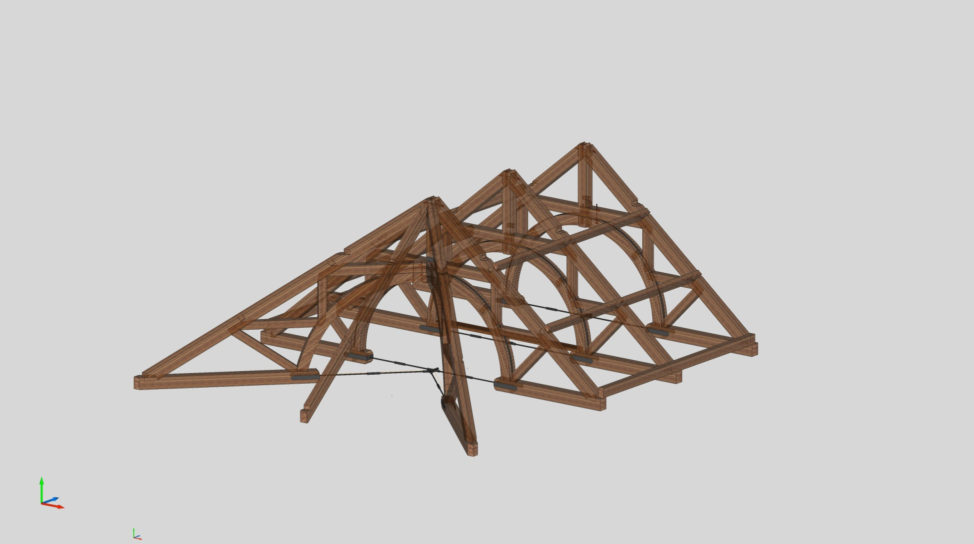
Fly and Fit End Rafter
DAY 3

Slide 14
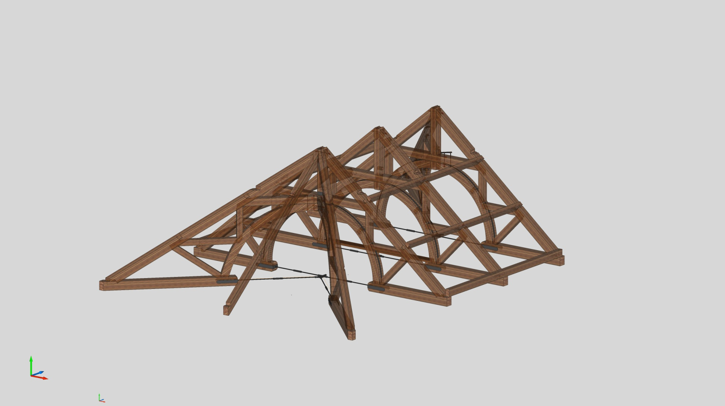
Fly and Fit Hip Truss - #3
DAY 3

Slide 15
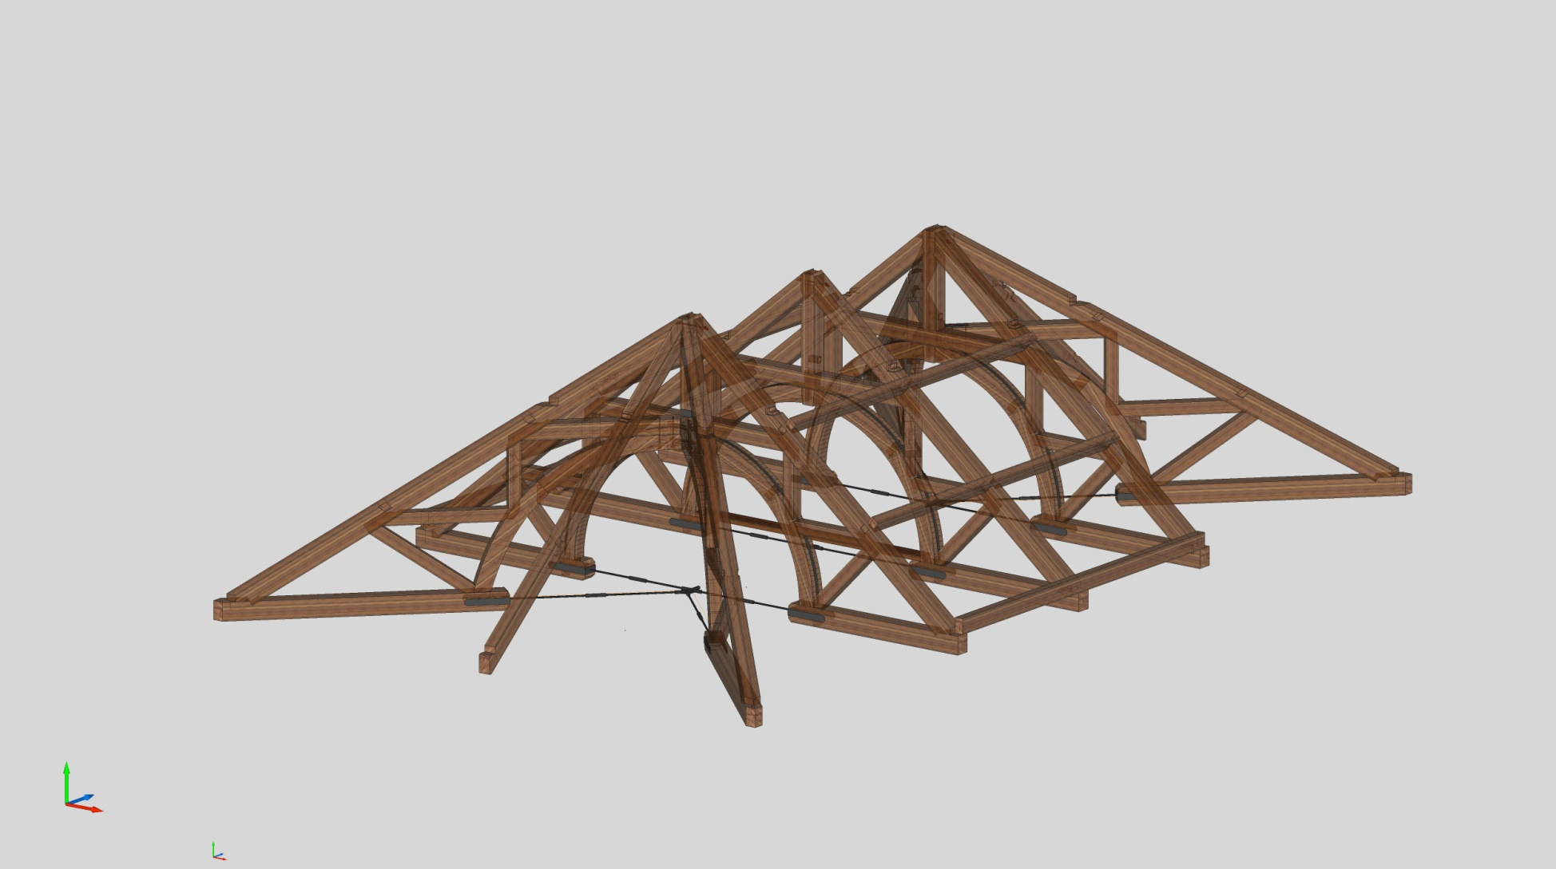
Fly and Fit Hip Truss - #4
DAY 3

Slide 16
DAY 4
25 February 2014

Slide 17
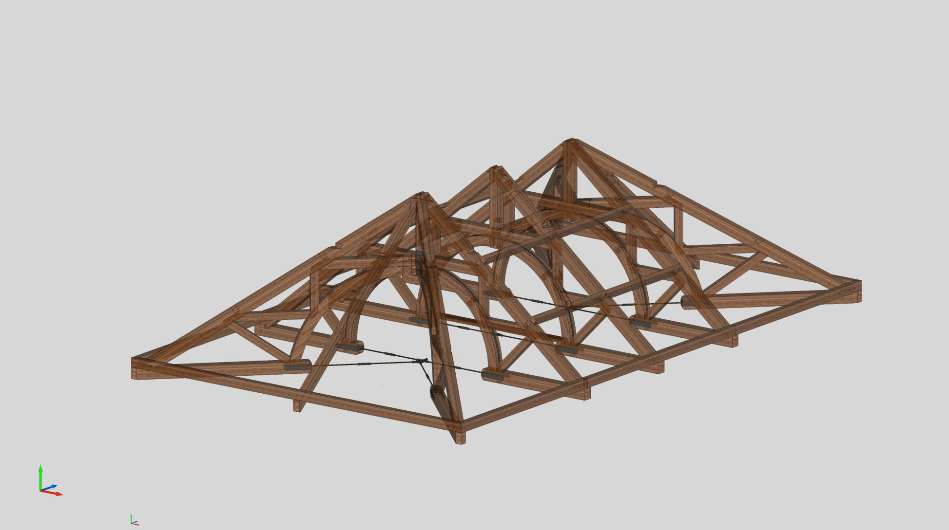
Fit Hip Rafter Plates
DAY 4

Slide 18
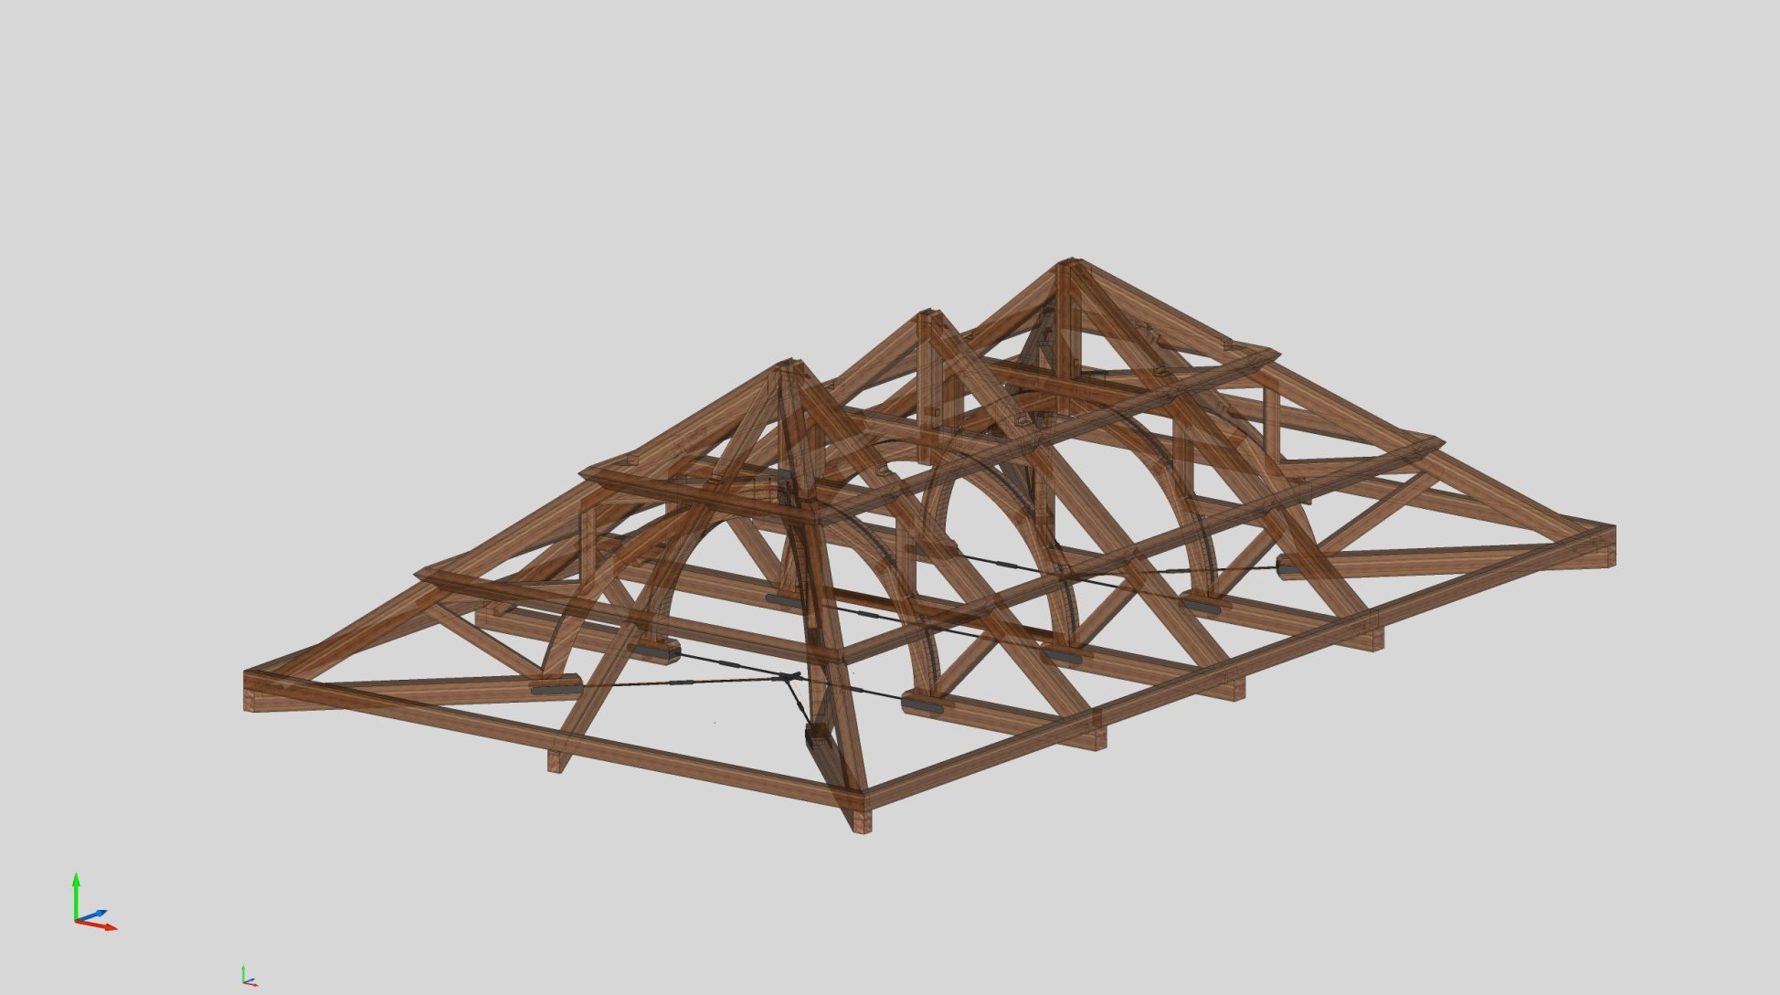
Fit Hip Purlins
DAY 4

Slide 19
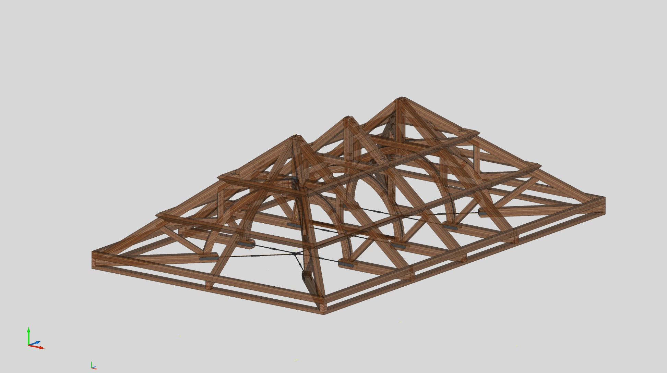
l
DAY 4

Slide 20
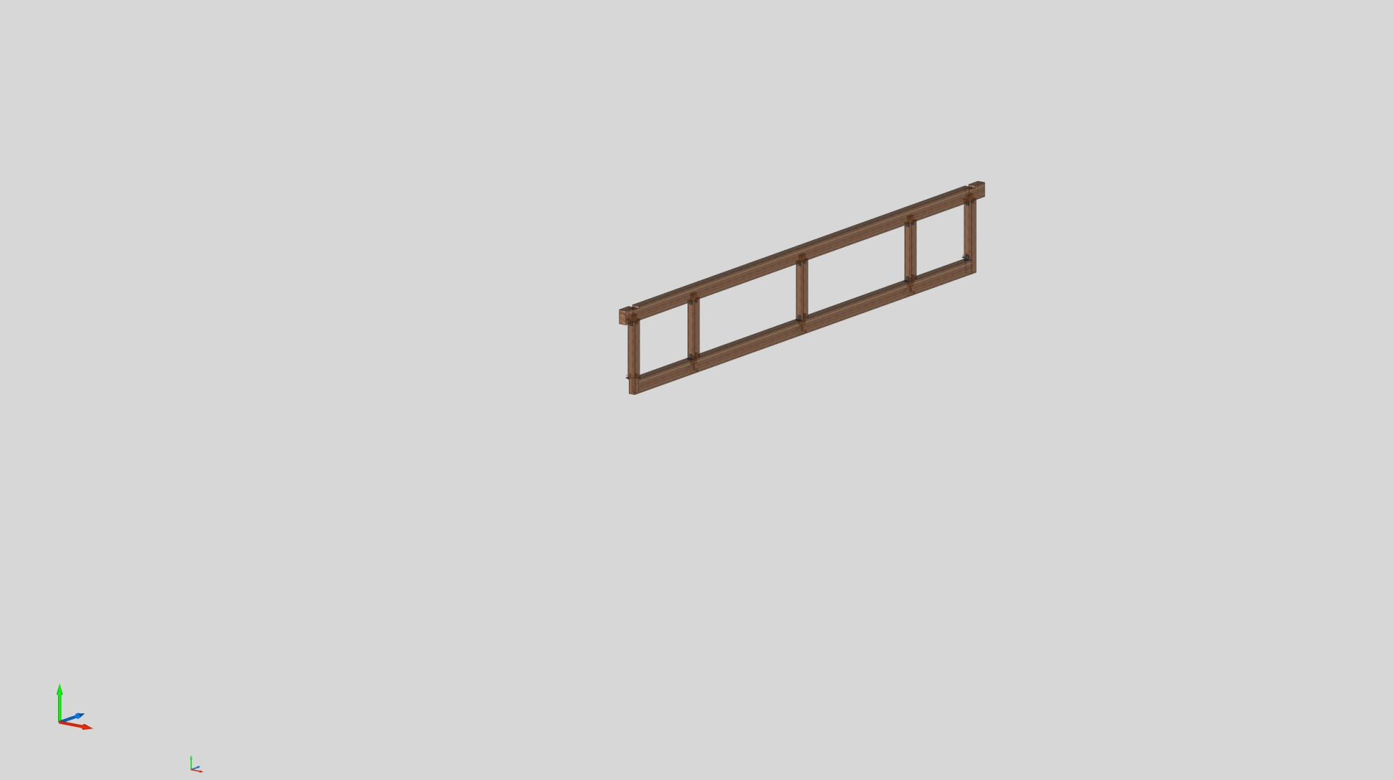
Assemble Widows Walk Walls
DAY 4

Slide 21
DAY 5
26 February 2014

Slide 22
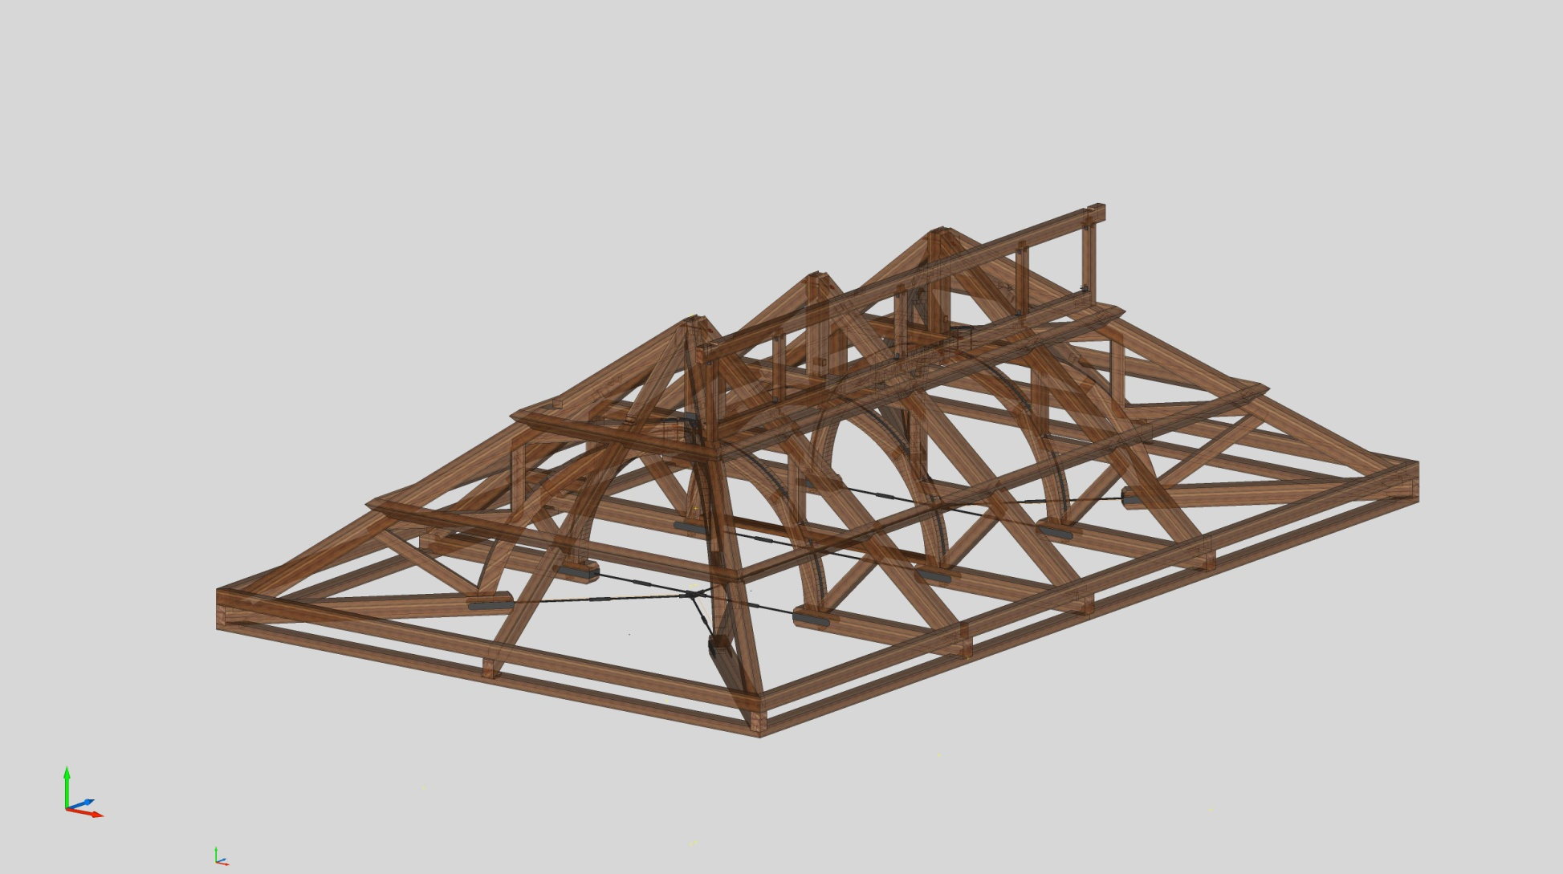
Fly Widows Walk Walls - #1
DAY 5

Slide 23
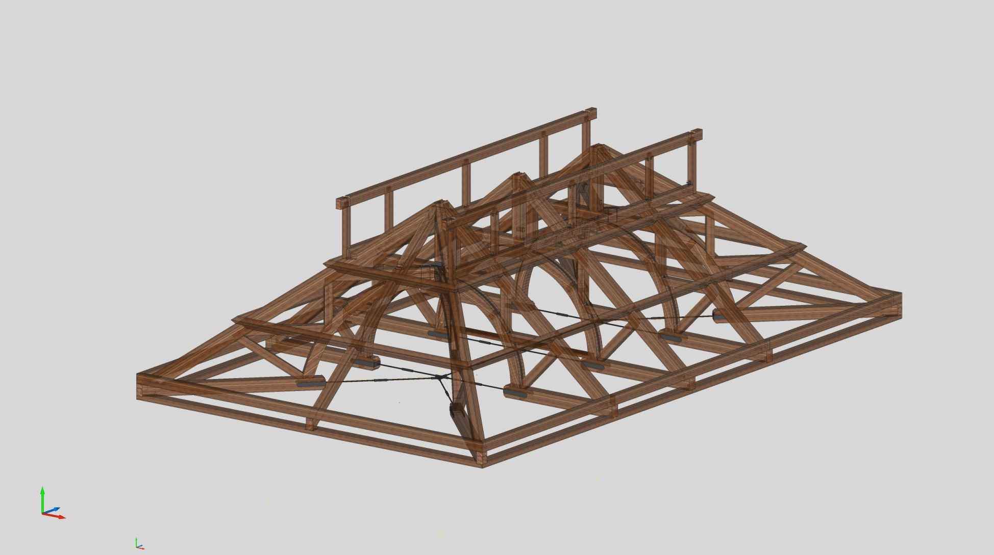
Fly Widows Walk Wall - #2
DAY 5

Slide 24
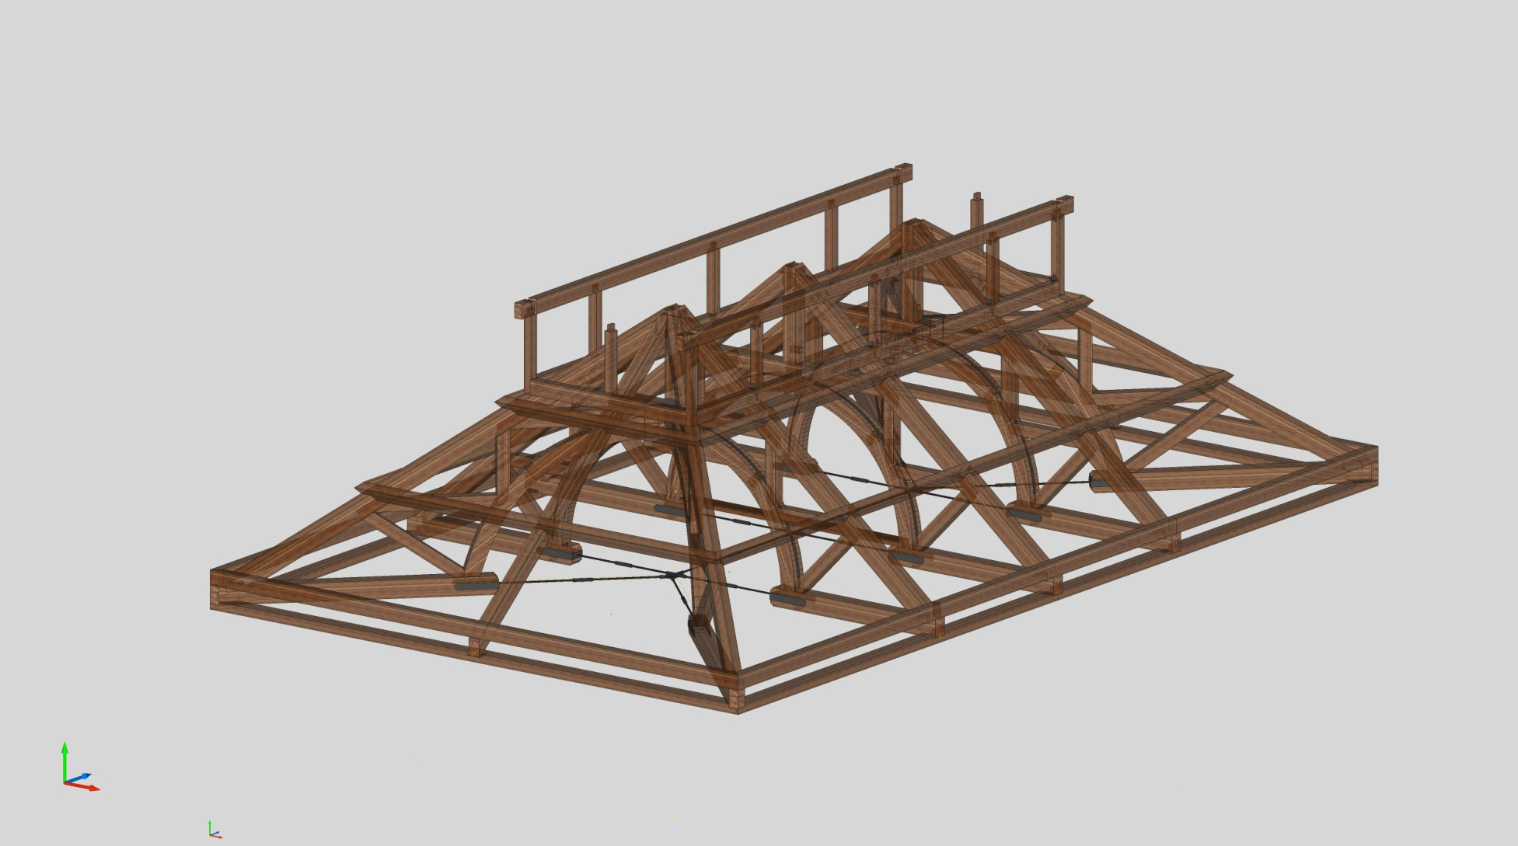
Fit Center Beam
DAY 5

Slide 25
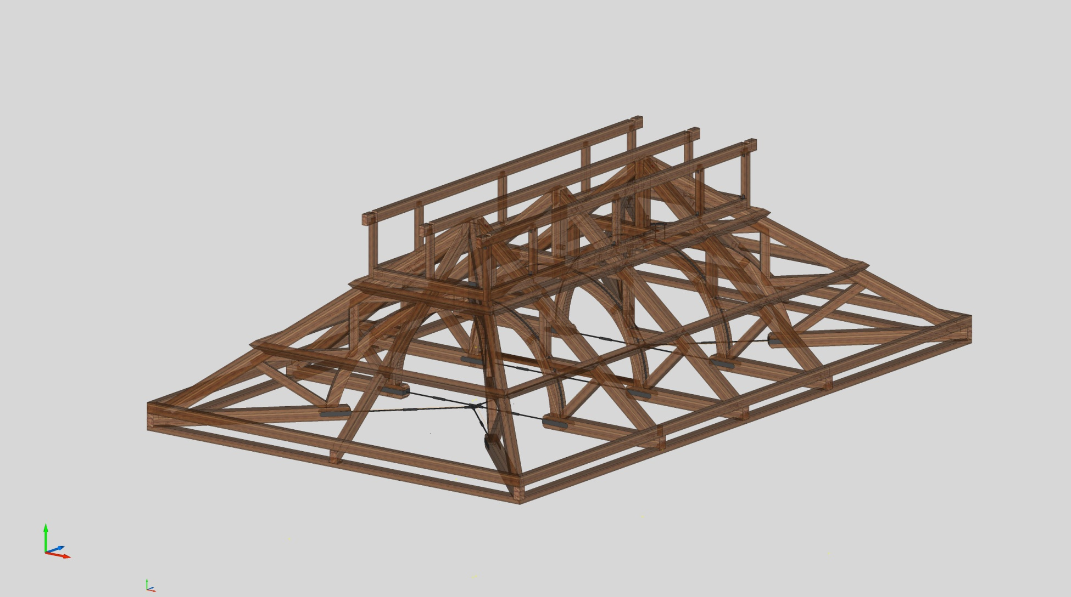
Fit Center Beam
DAY 5

Slide 26
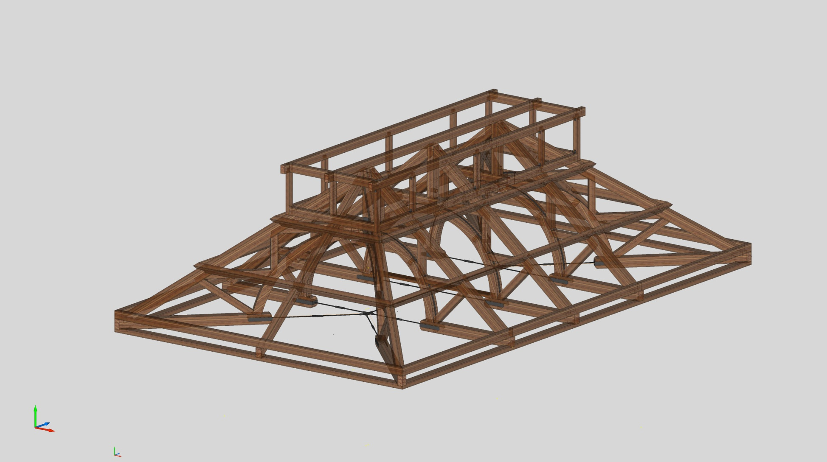
Finish Widows Walk

Slide 27
DAY 6
27 February 2014

Slide 28
Clean Up Loose ends
DAY 6

Slide 29
DAY 7
28 February 2014

Slide 30
Load Out and Contingency
DAY 7

Slide 31
NOTES

Slide 32
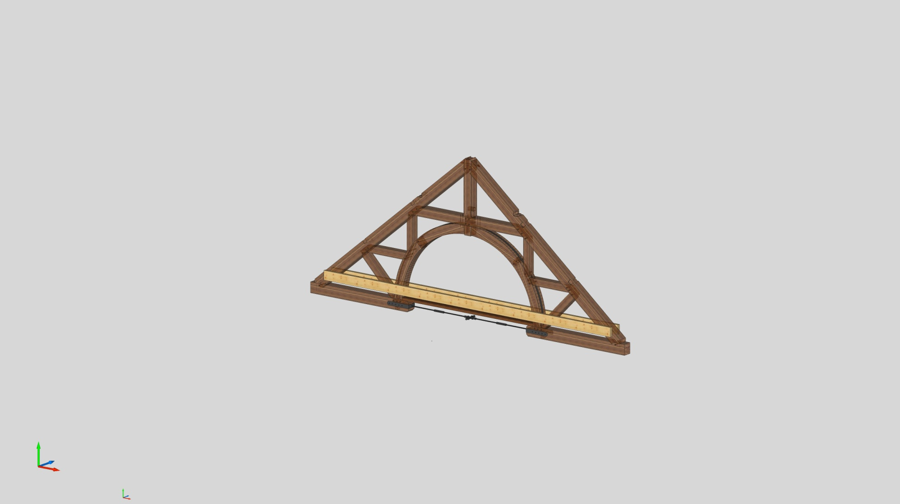
Truss Packaging – For Transport

